Slide 1
Artificial Intelligence
Support Vector Machines II

Slide 2
Overview
New material: Multi-class problems with Support Vector Machines
Some other bits of housekeeping (before Nick takes over)

Slide 3
Second term topics: details
Data exploration and preparation (1 week)
We need to add some of the basic bits we skipped last term
Evaluation (2 weeks)
Really important: we all need to know the important methods for establishing exactly how well our ML methods are performing
Feature extraction (2 weeks)
Really interesting topic: if our data doesn’t have a really obvious consistent structure (e.g., text documents, images) then how should we extract features
Support Vector Machines (2 weeks)
A final “black box” technique we think you should have some exposure to (e.g., visualising, tuning hyperparameters)
Then over to Deep Learning with Nick (3 weeks, not assessed)

Slide 4
Lectures: reminder
The last 3 lectures this term are not assessed by the exam
We hope you will enjoy them, find them interesting, and attempt the lab exercises…
…But it’s fine to come to labs and ask about/do work on the practice questions instead
The unit is structured in this way to give you the option
Week commencing | Title
07/01/2019 | Consolidation
14/01/2019 | Data Exploration and Preparation
21/01/2019 | Evaluation I
28/01/2019 | Evaluation II
04/02/2019 | Feature Extraction I
11/02/2019 | TUTOR WEEK
18/02/2019 | Feature Extraction II
25/02/2019 | Support Vector Machines I
04/03/2019 | Support Vector Machines II
11/03/2019 | Deep Learning I
18/03/2019 | Deep Learning II
25/03/2019 | Deep Learning III
1CWK50
1EXAM50
These lectures are for your interest and are not assessed

Slide 5
SVMs: important steps
Important ideas to cover:
Binary classification only
Linear boundaries
The margin
Soft margins
Nonlinear boundaries
The KernelScale hyperparameter
Matlab syntax
Visualisation and other considerations

Slide 6
SVMs: important steps
Important ideas to cover:
Binary classification only – sounds like a big limitation
Linear boundaries
The margin
Soft margins
Nonlinear boundaries
The KernelScale hyperparameter
Matlab syntax
Visualisation and other considerations

Slide 7
Binary classification only
Error!

Slide 8
Binary classification only
- Setosa
- Versicolor
- Virginica
Error!
We’ll think about the 3-class iris data as our main example in these slides, represented by the simplified sketch of sepal sizes, above

Slide 9
Combining binary classifiers
There are a whole family of techniques for combining multiple, individual, binary classifiers to achieve multi-class classification
Also used with other binary classifiers, not just SVMs
Two main approaches:
“One versus all” (OVA)
“One versus one” (OVO)
There are subtly different variations* (aimed at giving slightly better performance), but the core ideas are the same…
…and are hopefully fairly intuitive
* Including the Matlab implementations we’ll see later

Slide 10
One versus all (OVA)
Try to classify between one single class versus all the rest of your classes (and repeat for all classes)
Example based on iris data:
Train an SVM to classify between [setosa irises] and [versicolor or virginica irises]
Train an SVM to classify between [versicolor irises] and [setosa or virginica irises]
Train an SVM to classify between [virginica irises] and [setosa or versicolor irises]
At testing time, classify a new example with every SVM, and assign to the individual class with the highest score

Slide 11
One versus all (OVA)
- Setosa
- Versicolor
- Virginica
“One”
“All”
“All”
“One”
“All”
“One”

Slide 12
One versus all (OVA)
- Setosa
- Versicolor
- Virginica
“One”
“All”
“All”
“One”
“All”
“One”

Slide 13
One versus all (OVA)
- Setosa
- Versicolor
- Virginica
“One”
“All”
Score = 0.004
“All”
“One”
Score = 0.86
Score = 0.012
“All”
“One”

Slide 14
One versus all (OVA)
- Setosa
- Versicolor
- Virginica
“One”
“All”
Score = 0.004
“All”
“One”
Score = 0.86
Score = 0.012
“All”
“One”
Winner = Versicolor

Slide 15
One versus all (OVA)
- Setosa
- Versicolor
- Virginica
“One”
“All”
Score = 0.004
“All”
“One”
Score = 0.86
Score = 0.012
“All”
“One”
Winner = Versicolor

Slide 16
One versus one (OVO)
Try to classify between one single class versus one other class (and repeat for all pairs of classes)
Example based on iris data:
Train an SVM to classify between [setosa irises] and [versicolor irises]
Train an SVM to classify between [setosa irises] and [virginica irises]
Train an SVM to classify between [virginica irises] and [versicolor irises]
At testing time, classify a new example with every SVM, keep a tally of results, and assign to the class with the largest number of wins

Slide 17
One versus one (OVO)
- Setosa
- Versicolor
- Virginica
“Setosa”
“Setosa”
“Virginica”
“Virginica”
“Versicolor”
“Versicolor”

Slide 18
One versus one (OVO)
- Setosa
- Versicolor
- Virginica
“Setosa”
“Setosa”
“Virginica”
“Versicolor”
“Virginica”
“Versicolor”

Slide 19
One versus one (OVO)
- Setosa
- Versicolor
- Virginica
“Setosa”
“Setosa”
“Virginica”
“Versicolor”
“Virginica”
“Versicolor”

Slide 20
One versus one (OVO)
- Setosa
- Versicolor
- Virginica
“Setosa”
“Setosa”
“Virginica”
“Versicolor”
“Virginica”
“Versicolor”
Winner = Setosa
Winner = Versicolor
Winner = Versicolor

Slide 21
One versus one (OVO)
- Setosa
- Versicolor
- Virginica
“Setosa”
“Setosa”
“Virginica”
“Versicolor”
“Virginica”
“Versicolor”
Winner = Setosa
Winner = Versicolor
Winner = Versicolor
Overall winner = Versicolor

Slide 22
One versus one (OVO)
- Setosa
- Versicolor
- Virginica
“Setosa”
“Setosa”
“Virginica”
“Versicolor”
“Virginica”
“Versicolor”
Winner = Setosa
Winner = Versicolor
Winner = Versicolor
Overall winner = Versicolor

Slide 23
OVO: other considerations
How many pairs?
[Fun to think about: room of N people who don’t know each other – how many handshakes take place?]
N*(N-1) / 2
E.g., for the 10-class digit classification problem example in labs: we need to train 10*(9) / 2 = 45 binary SVMs!
However, each SVM only trained on a relatively small subset of the data
Approx. 2/10ths or 20%, assuming balanced classes

Slide 24
OVA: other considerations
We just need one model per class
E.g., for the 10-class digit classification problem example in labs: we need to train 10 binary SVMs
However, each SVM is trained on all of the data
SVM training can be slow for lots of examples (complexity is cubic in the number of examples)…
…So OVO generally preferred as it is faster to train more SVMs on smaller subsets of the data (rather than fewer SVMs on all data)
OVO vs OVA classification accuracy often v similar (see later slides)

Slide 25
Matlab syntax: OVO with SVMs
See for practice questions: m = fitcecoc(examples, labels, 'Coding', 'onevsone');
Train a collection of binary SVMs (with soft margins) in a one-versus-one (OVO) approach
Can then call predict() in the usual way (for our purposes)

Slide 26
Matlab syntax: OVA with SVMs
See for practice questions: m = fitcecoc(examples, labels, 'Coding', 'onevsall');
Train a collection of binary SVMs (with soft margins) in a one-versus-all (OVA) approach
Can then call predict() in the usual way (for our purposes)

Slide 27
Matlab syntax: non-standard SVMs
See for practice questions: If you want to use a non-default SVM, then you can set it up using the templateSVM() function
E.g., to use the kernel trick with an RBF kernel and KernelScale of 0.5
t = templateSVM('KernelFunction','rbf','KernelScale', 0.5)
All parameters you don’t specify are set to their default
And then pass it to fitcecoc() using an extra 'Learners' name-value pair:
E.g., OVO approach using the SVM defined above
m = fitcecoc(examples,labels,'Coding','onevsone','Learners',t);

Slide 28
Visualisation
See for practice questions: (just as last week) there’s no easy way to see what the boundary looks like…
…You don’t get back the equation/vertices of a line/plane…
To visualise the boundary, you need to build yourself a dense rectangular “grid” of testing data that covers the min/max extents of your training features… E.g., using a nested for loop
…And use predict() to find the classifier’s prediction at every point
You can then use gscatter() to visualise the results…
…And overlay the training data

Slide 29
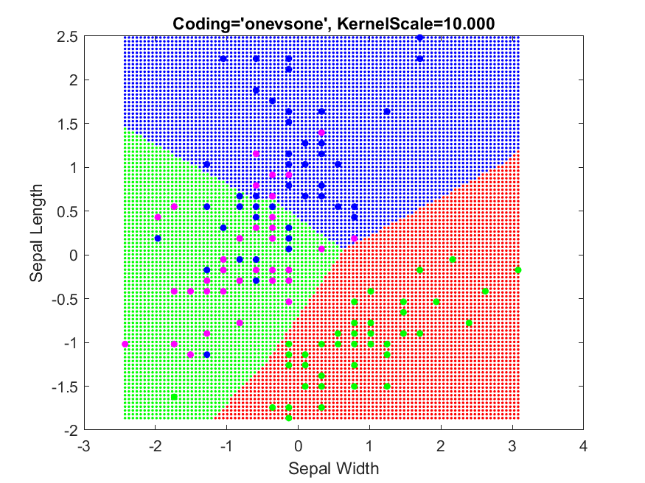
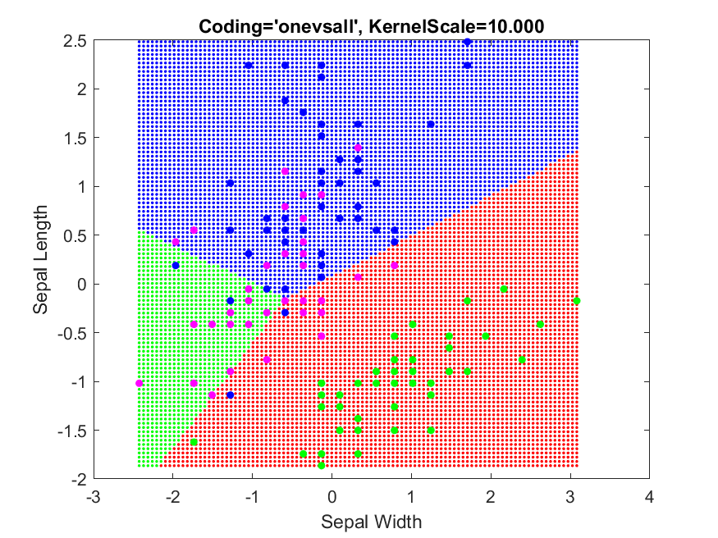
Visualisation: changing KernelScale
One-versus-one (OVO)
One-versus-all (OVA)

Slide 30
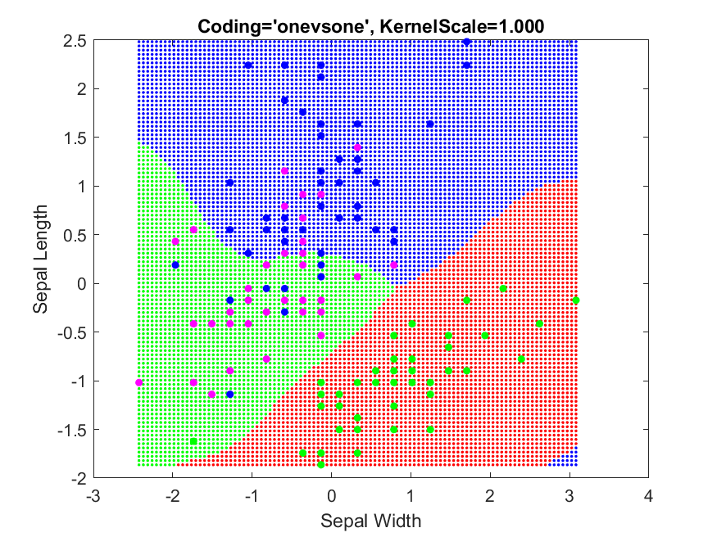
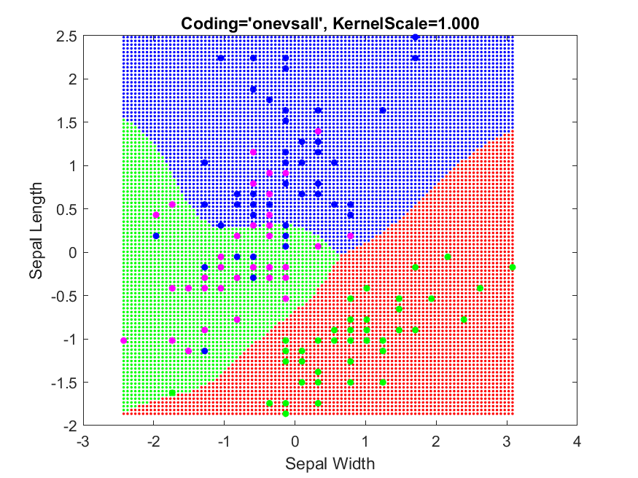
Visualisation: changing KernelScale
One-versus-one (OVO)
One-versus-all (OVA)

Slide 31
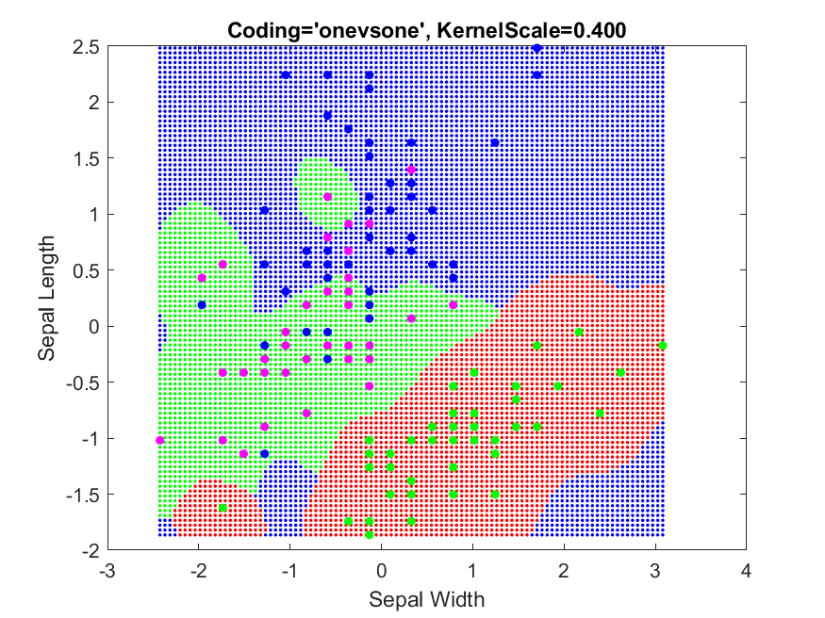
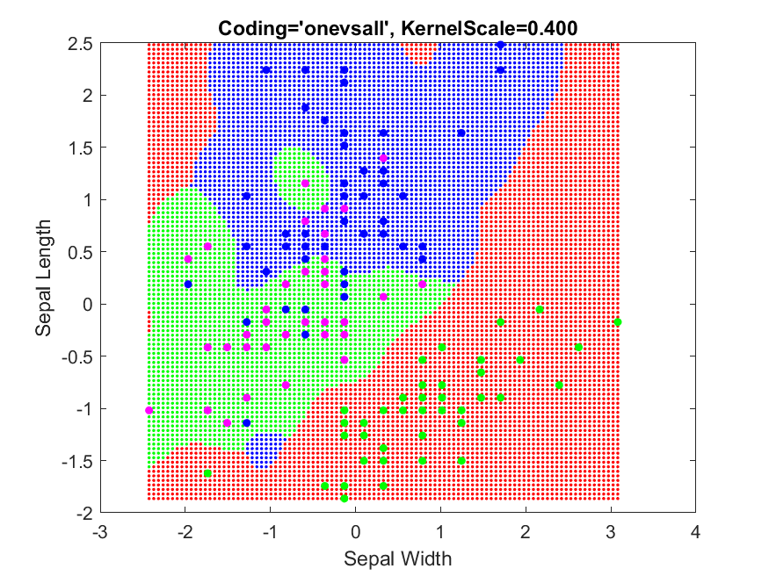
Visualisation: changing KernelScale
One-versus-one (OVO)
One-versus-all (OVA)

Slide 32
Other considerations
For interest only, not examined…
You can use Matlab’s 'OptimizeHyperparameters' option to automatically optimise hyperparameters (just as in previous weeks) and the coding strategy (new) using cross-validation
For SVMs: BoxConstraint, KernelScale and Coding is the default behaviour using 'auto'
Warning: can be slow if you have much data…

Slide 33
Topics to revisit?
No special requests
So just an FAQ on the exam

Slide 34
Exam: FAQ – see also week 13
Is it open book? No, because you can’t take in books, or written notes, but it’s similar. Here are some other things you can’t have at your desk: coats, bags, phones, pens, paper, calculators
How many questions? Eight, from which you answer any 5
How long is it? 3 hours, and this includes time for downloading from/uploading to Moodle – you need to be organised
Can I take my own portable hard drive in? No external drives, please organise your work on the H: drive
Can I take my own laptop in? No, you must use one of the lab machines
Can I put anything I want on my H: drive? Short answer: yes
Can I access Moodle? Yes
Can I go on the Internet? Yes
If I do all the lab questions, can I really get 100%? Yes. The questions aren’t the same, but they test the same skills/knowledge. (Someone who just copies solutions to practice questions from a friend without understanding them is likely to fail)
Can I ask for help with Matlab during the exam? No, it is invigilated by people with no Matlab knowledge

Slide 35
Reading for next week
Goodfellow et al., “Deep Learning”
Available in the “Neural Networks Materials” section on Moodle
Chapter 9: “Convolutional Networks”
Particularly pp. 330-347
(This refers to the actual numbers written on bottom of the pages, not any browser estimate)
Suggested approach: just relax and read straight through

Slide 36
Lectures: reminder
The last 3 lectures this term are not assessed by the exam
We hope you will enjoy them, find them interesting, and attempt the lab exercises…
…But it’s fine to come to labs and ask about/do work on the practice questions instead
The unit is structured in this way to give you the option
Week commencing | Title
07/01/2019 | Consolidation
14/01/2019 | Data Exploration and Preparation
21/01/2019 | Evaluation I
28/01/2019 | Evaluation II
04/02/2019 | Feature Extraction I
11/02/2019 | TUTOR WEEK
18/02/2019 | Feature Extraction II
25/02/2019 | Support Vector Machines I
04/03/2019 | Support Vector Machines II
11/03/2019 | Deep Learning I
18/03/2019 | Deep Learning II
25/03/2019 | Deep Learning III
1CWK50
1EXAM50
These lectures are for your interest and are not assessed

